Slide 1
The Customer Experience through Text Mining
Eduardo Carrascosa
Muhammad Khan
Sanchiit Podaar
Notes:
Eduardo introduces team, project
Warmer, engage audience, use statistics to show purpose/(problem to be solved)
How many of you have filled out a customer service survey to rate your Customer Service Agent (CSA) after they have helped you resolved an issue?
Statistics
Typical response rate in a customer survey is 10-15%
86% of customers will pay more for a better customer service experience
82% of customers have left a company because of bad customer service

Slide 2
Objectives
Create mechanism to automatically assess the customer’s experience (customer sentiment) using sentiment analysis on conversational models (interactions with Customer Service Agents (CSA)
Provide insight into the 85% of customers who seek assistance but don’t tell us whether they are satisfied or not
Notes:
Eduardo introduces the context/purpose of the project at a high level

Slide 3
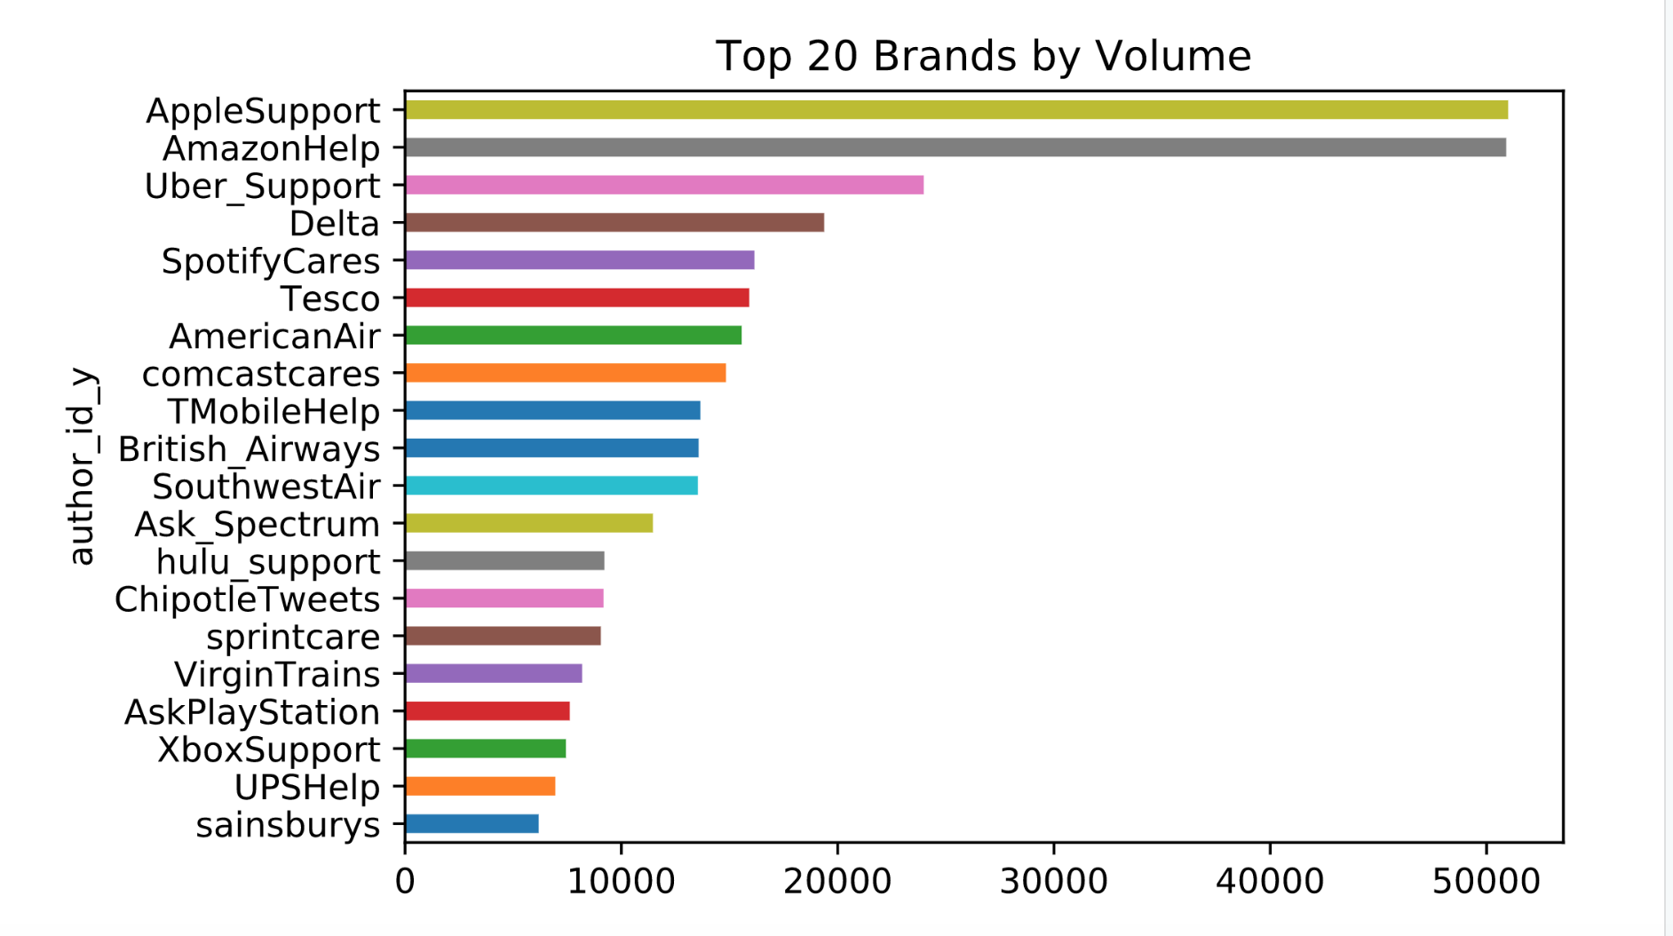
The dataset: ”Customer Support on Twitter”
Notes:
Key Points
Customer Support on Twitter dataset
Each tweet is either a customer request/response or a response from a customer service agent
We focused on UPSHelp
Captured 13 total customer interactions with @UPSHelp from beginning to end
Other Notes
-Approx 10,000 tweets from UPSHelp not including INBOUND tweets
-Dataset - The Customer Support on Twitter dataset is a large, modern corpus of tweets and replies to aid innovation in natural language understanding and conversational models, and for study of modern customer support practices and impact.

Slide 4
Design phase one
Tools
Python for sensitivity analysis
Excel for customer experience rating
Attributes
Tweet_ID | Author_ID | Inbound | Created_at | Text | Response_tweet_id | In_reponse_to_tweet_id
Calculated fields
Start_sentiments | End_Sentiment | Sentiment Change
0.3802 | 0 | -0.3802
-0.296 | 0.3612 | 0.6572
0.5574 | 0.4767 | -0.0807
-0.1511 | 0 | 0.1511
-0.2111 | 0.34 | 0.5511
0.4019 | 0.4404 | 0.0385
Customer Sentiment | Sentiment Change
Start - End = SENTIMENT CHANGE
Notes:
Key Points:
-Used python to find the initial customer request (INBOUND = TRUE and In_response_to_tweet_id = NULL)
-Find rest of conversation by Author and apply vader sentiment analysis to each inbound tweet
- Add Customer_Sentiment” attribute and export CSV file
--Extract FIRST and LAST INBOUND Tweet by Author to calculate Sentiment_Change
Attributes contained in the dataset
- Author_ID, for identifying users,
Inbound+In_Response_to_tweet_ID to identify initial inquiry
Text – the customer requests and response from UPS Help
Created_at to calculate sentiment change over time
Calculated fields
1) Customer Sentiment
2) Sentiment Change

Slide 5
Design phase two: Key Metrics
Sentiment Change | Rating | Success/Failure
-0.3802 | 2.02475 | failure
0.6572 | 3.3215 | success
-0.0807 | 2.399125 | failure
0.1511 | 2.688875 | success
0.5511 | 3.188875 | success
0.0385 | 2.548125 | success
0.4939 | 3.117375 | success
0.8016 | 3.502 | success
0.1761 | 2.720125 | success
0.755 | 3.44375 | success
0.645 | 3.30625 | success
-0.9189 | 1.351375 | failure
-0.7775 | 1.528125 | failure
Rank
1.351375 | failure
1.528125 | failure
2.02475 | failure
2.399125 | failure
2.548125 | success
2.688875 | success
2.720125 | success
3.117375 | success
3.188875 | success
3.30625 | success
3.3215 | success
3.44375 | success
3.502 | success
Notes:
Key points:
Using the sentiment change of each customer we developed two metrics to gauge the customer satisfaction and/or effectives of UPSHelp Customer Support on Twitter
Two designs:
First
– Does customer sentiment change from negative to positive or if interaction moves from positive to higher positive = Success, it not = Failure
- Judge success rate by dividing success/total interactions
Second
– 1-5 Rating using mathematical formulta to convert the sentiment change into a 1-5 scale

Slide 6
Implications/Future Development Implementation
Model can be further automated to process more data points
Model can be further expanded to rate customer service calls by using text mining on the call transcripts
Additional metrics/mathematical formulas can be implemented for different measurements of success such as the efficiency with which a request is handled ( ex. Can a positive result be obtained in one message or does it take 10 messages?)
Model’s accuracy can be improved by using real customer surveys to train the model

Slide 7
Conclusion
At the highest level having an automated way of judging the customer experience/sentiment of customers when interacting with our agents will give us valuable information into what is working and what isn’t. Improving the customer experience, increases the customer lifetime value (profits), grows the customer base, and increases overall shareholder value

Slide 8
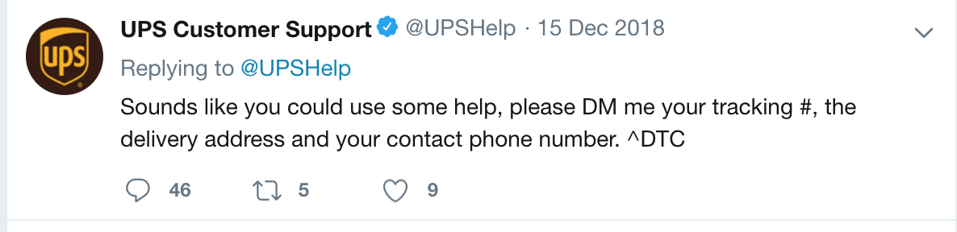
THANK YOU

